Slide 1
Java Applets

Slide 2
Introduction to Java Applet Programs
Applications are stand alone programs
  executed with Java interpreter
Applet is a small program
  can be placed on a web page
  will be executed by the web browser
  give web pages “dynamic content”

Slide 3
Java Applets
Built using one of general definitions of applets
  Applet class
  JAapplet class
Java applets are usually graphical
  Draw graphics in a defined screen area
  Enable user interaction with GUI elements

Slide 4
Java Applet Classes
Abstract Windowing Toolkit AWT
  Earlier versions of Java
  Applet class is one of the AWT components
Java Foundation Classes JFC
  Extension to Java in 1997
  Has a collection of Swing components for enhanced GUIs
  Swing component classes begin with J

Slide 5
Java Applets
Applets are Java programs that can be embedded in HTML documents
  To run an applet you must create a .html file which references the applet
  Ready to Program also will run an applet
When browser loads Web page containing applet
  Applet downloads into Web browser
  begins execution
Can be tested using appletviewer program

Slide 6
Contrast Application with Applet
Application | Applet
Object class extended Class not declared public Has a main() static keyword used Uses System.exit(1) | JApplet class extended class declared to be public init() instead of main() init() not declared with static keyword

Slide 7
Applet Declaration
Syntax (note difference from application declaration)
public class ClassName extends JAapplet
ClassName is an object that will be a subclass of JApplet

Slide 8
Body of an Applet
Note there is no main() method in an applet
  JApplet class provides other methods instead of a main method
First method executed is the init() method

Slide 9
Applets
Applet
  Program that runs in
    appletviewer (test utility for applets)
    Web browser (IE, Communicator)
  Executes when HTML (Hypertext Markup Language) document containing applet is opened
  Applications run in command windows
Notes
  Focus on fundamental programming concepts first
    Explanations will come later

Slide 10
Applets and Web Pages – HTML
Applets embedded in a web page
  Executed when web page loaded by browser
Web pages structured with HTML codes
  HyperText Mark-up Language
Syntax
<command>
. . .
</command>
Turns format on
Turns the format off

Slide 11
Applets and Web Pages – HTML
Embedding Java applets
  Insert applet tags
  <APPLET>
  </APPLET>
Call the specific applet by its file name
  <APPLET CODE = "Whatever.class"
  WIDTH = nnn HEIGHT = mmmm>
  <\APPLET>
  Where nnn and mmm are specific pixel sizes

Slide 12
Applets and Web Pages – HTML
Create the web page code using a text editor
Save it with an .html suffix
Open this file with appletviewer or with a web browser that supports Java
Java Plug-in must be installed (part of J2SDK 1.4.1 from Sun)
<HTML>
<HEAD>
</HEAD>
<BODY>
<APPLET CODE = . . . >
</APPLET>
</BODY>
</HTML>

Slide 13
Applets and Web Pages – HTML
Client Web browser anywhere can access this web page from its host server
Embedded Java applet runs on client browser (of any type platform)
This means a client anywhere on any type of platform can run a piece of software developed on any other type of platform
Platform Independence

Slide 14
Thinking About Objects
Java an object-oriented language
  However, Java has constructs from structured programming
Object orientation
  Natural way to think about world and writing computer programs
    Object-oriented programming models the real world
  Attributes - properties of objects
    Size, shape, color, weight, etc.
  Behaviors - actions that objects can perform
    A ball rolls, bounces, inflates and deflates

Slide 15
Thinking About Objects
Object orientation (continued)
  Inheritance
    New classes of objects absorb characteristics of existing classes
  Information hiding
    Objects usually do not know how other objects are implemented
    We can drive cars without knowing how every part works internally

Slide 16
Thinking About Objects
Class - unit of Java programming
Java focuses on nouns (classes)
  C focuses on verbs and is action oriented
Contain methods
  Implement behaviors
Contain data
  Implement attributes
Classes are reusable
  Standardized, interchangeable parts

Slide 17

A Simple Java Applet: Drawing a String
Figure 3.6 – a welcome message applet
The .html code to run the applet in a browser
The program output shown in the Applet Viewer
<html>
<applet code = "WelcomeApplet.class" width = "300" height = "45">
</applet>
</html>

Slide 18
Running the Applet
Compile
  Use Ready to Program
  If no errors, bytecodes stored in WelcomeApplet.class
We must create an HTML file
  Loads the applet into appletviewer or a browser
  Ends in .htm or .html
To execute an applet
  Create an HTML file indicating which applet the browser (or appletviewer) should load and execute

Slide 19
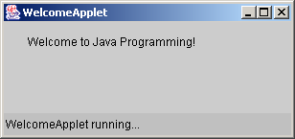
Running the Applet - Alternatively
Run from within Ready to Program
Prompt for applet window size appears
Applet window runs

Slide 20
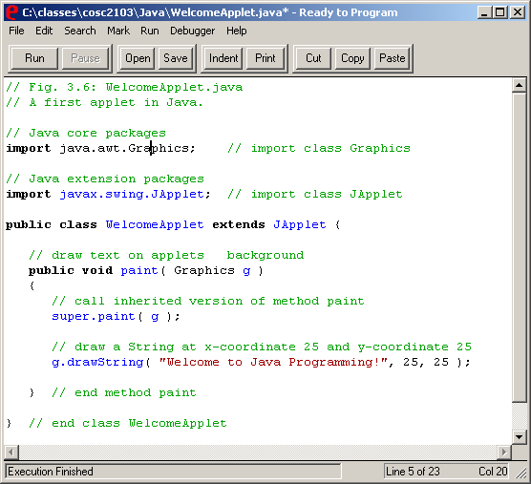
import allows us to use predefined classes (allowing us to use applets and graphics, in this case).
extends allows us to inherit the capabilities of class JApplet.
Method paint is guaranteed to be called in all applets. Its first line must be defined as above.

Slide 21
Running An Applet
import java.applet.Applet;
import java.awt.Graphics;
public class HelloApplet extends Applet {
public void paint (Graphics g)
{
g.drawString ("Hello. Welcome to",25,25);
g.drawString ("Java Programming",25,40);
}
}
Enter this text into your Ready to Program editor
Compile the Java code

Slide 22
Running An Applet
Now create an .html file to run the applet
Save it as HelloApplet.html
Make sure you save it in the same directory as the .java file
<html>
<applet code = "HelloApplet.class" width=275, height = 100>
</applet>
</html>

